Slide 1
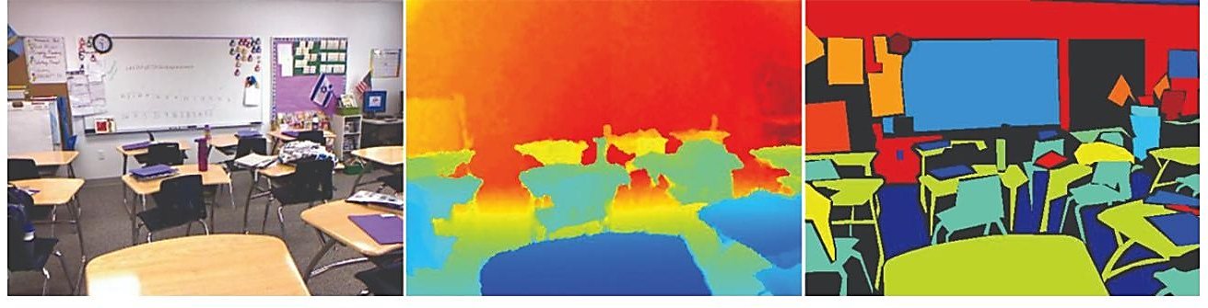
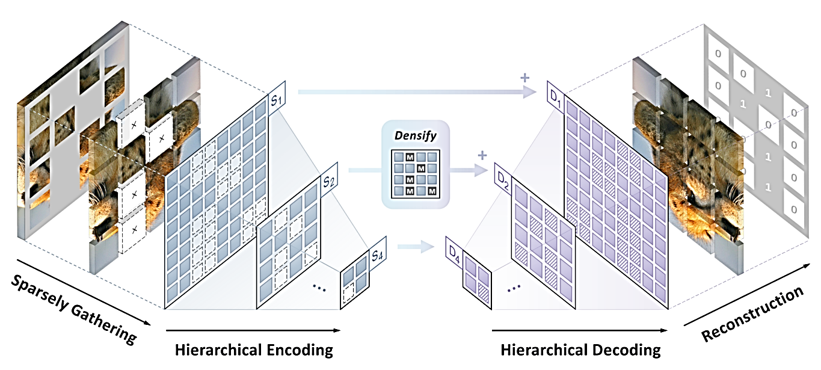
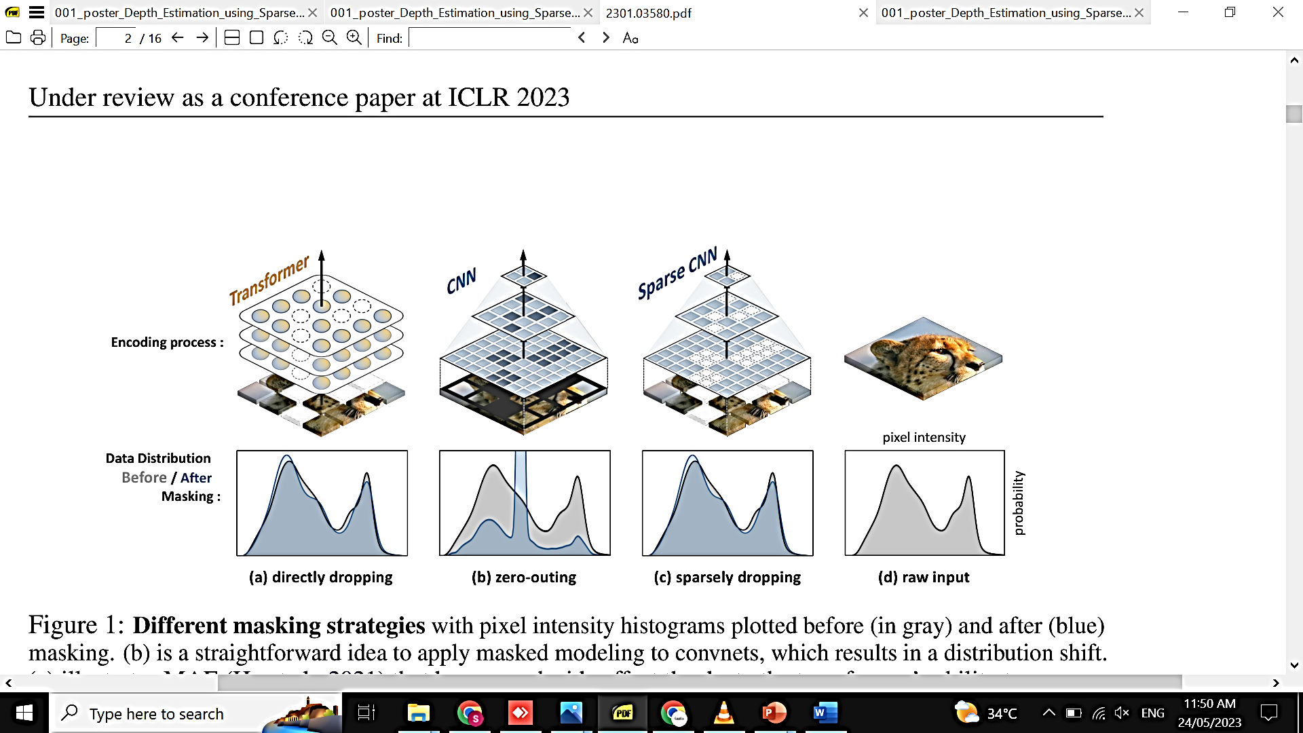
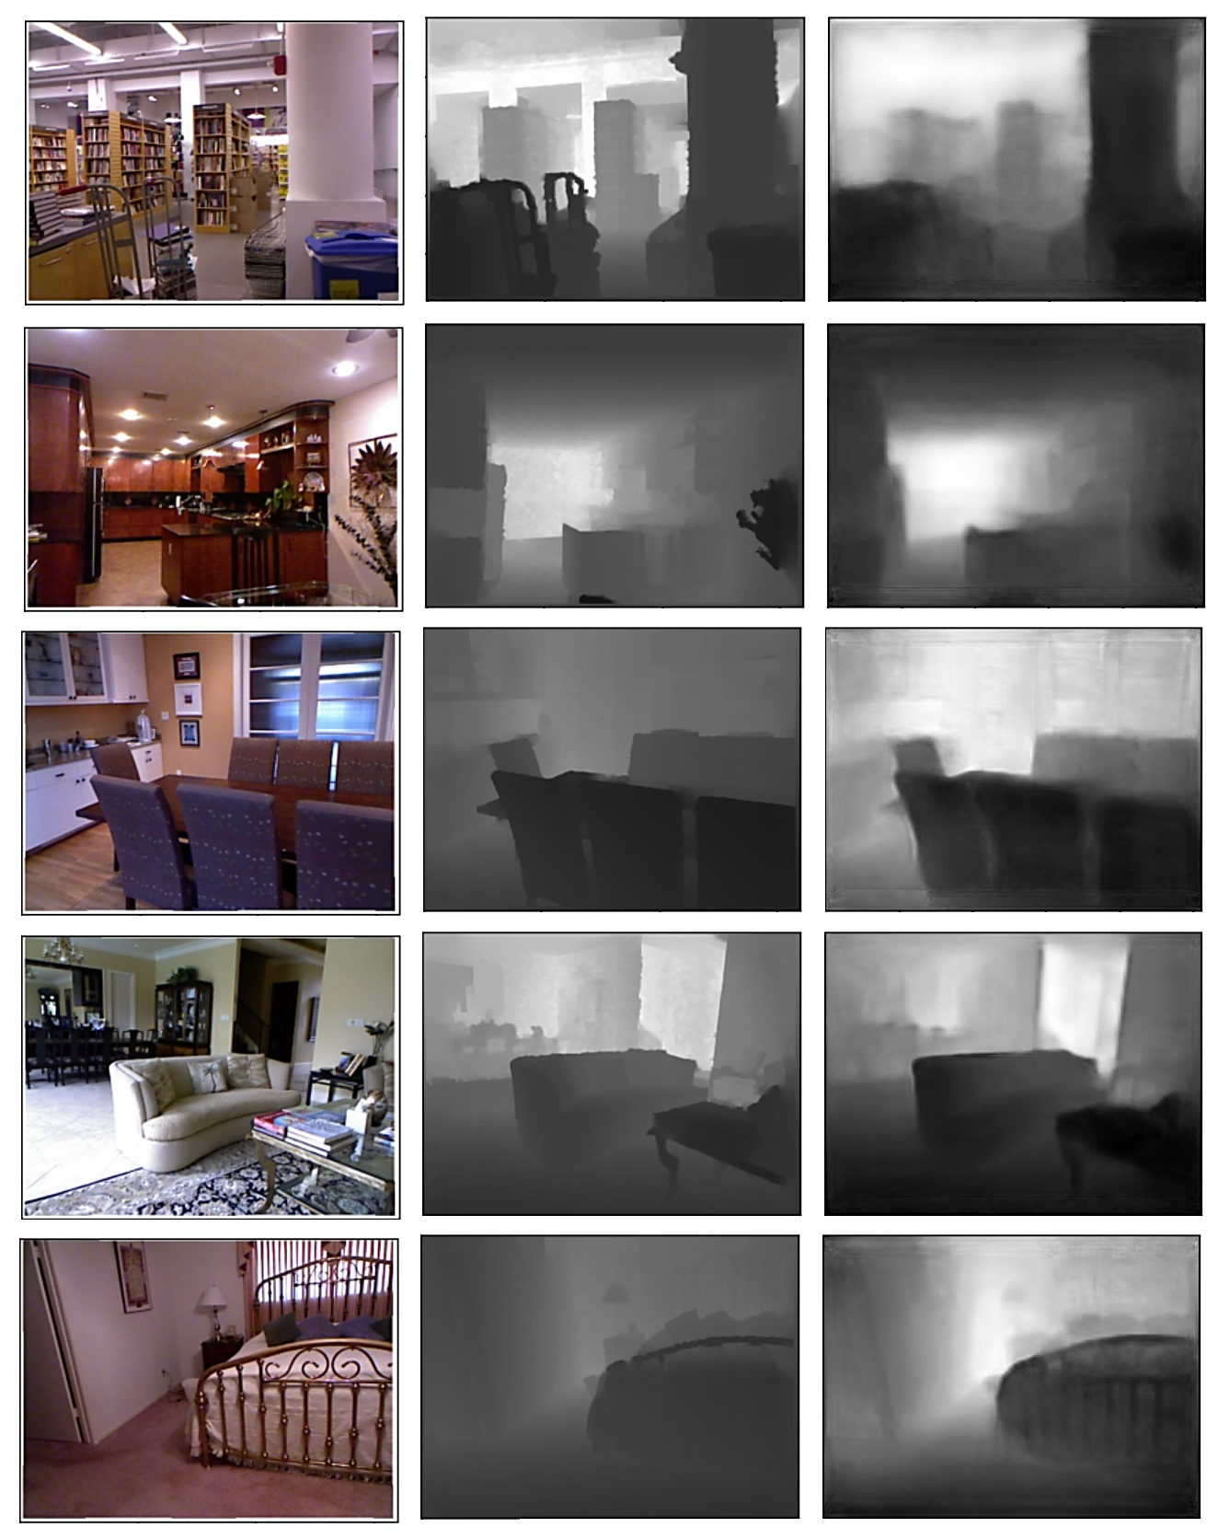
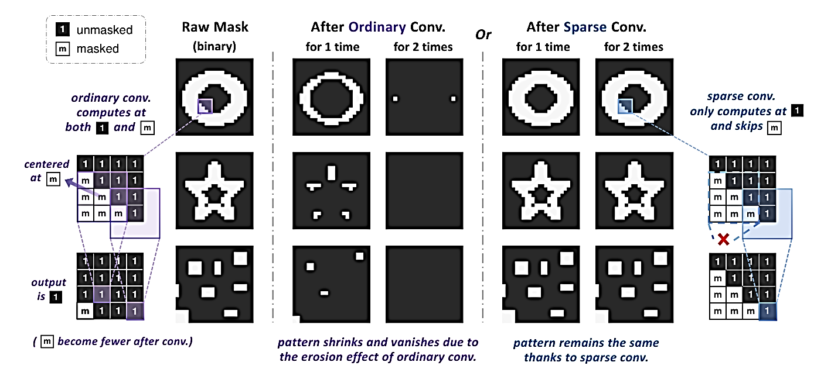
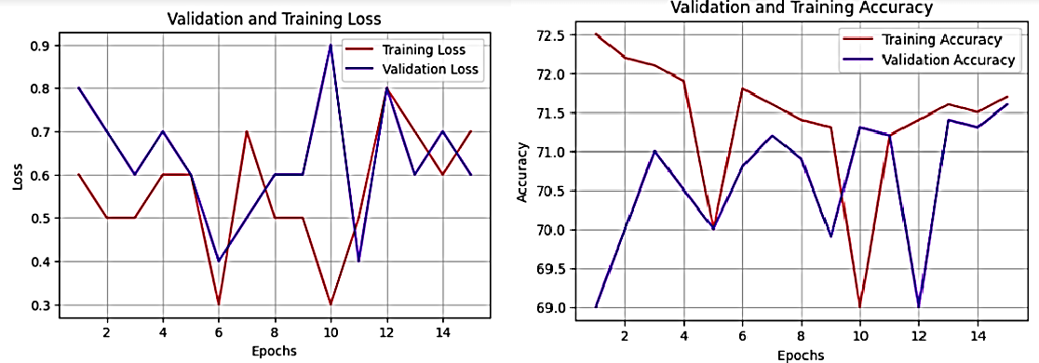
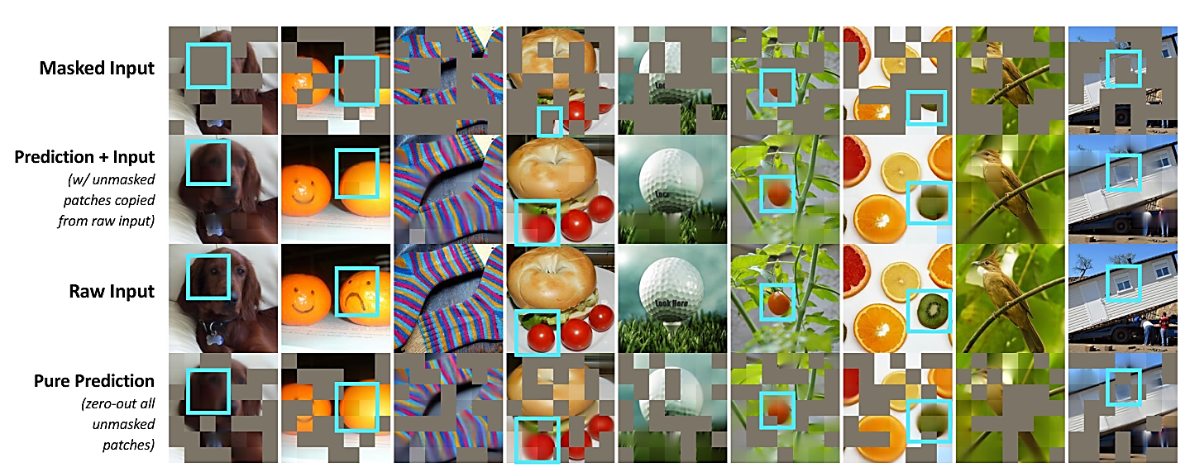
Single Image Depth Estimation using SparK Encoder Decoder
Deep Learning Course Project
Group 001
Group Members [Ramsha Imran (phdcs22003), Sadia Saeed (msds22012), Salwa Batool (msds22022), Momna Ibrahim (msds22054)]
Introduction Dataset
Depth estimation on an image using a sparse and hierarchical encoder and decoder involves the following key aspects:
Sparse encoding:
Utilize sparse convolution techniques to encode the image, treating unmasked pixels as sparse voxels forming 3D point clouds.
Sparse encoding allows for handling irregular and randomly masked input images, overcoming the limitations of convnets that rely on convolution operations.
Hierarchical decoding:
Employ a hierarchical decoder that reconstructs depth information from multi-scale encoded features.
The hierarchical decoder aligns with the hierarchical structure of convnets, effectively leveraging the benefits of BERT-style pre-training in convnet architectures.
The NYU Depth V2 dataset is a popular dataset for depth estimation, which consists of RGB images and corresponding depth maps. The dataset contains a total of 1,449 pairs of RGB and depth images.
Specifically, the dataset is divided into two subsets for training and testing:
Training set: The NYU Depth V2 training set consists of 795 RGB-depth image pairs.
Testing set: The NYU Depth V2 testing set contains 654 RGB-depth image pairs.
Problem Statement
The depth estimation problem involves determining the relative distances or depths of objects in a given image or scene. The goal is to assign a depth value to each pixel or region in the image, indicating how far away it is from the camera.
Figure4: Output from the RGB camera (left), preprocessed depth (center) and a set of labels (right) for the image.[2]
Applications
Methodology
Autonomous Driving
Robotics: Tasks like object manipulation, grasping, and navigation. Augmented Reality (AR): Estimating the depth of the scene, virtual objects can be rendered at the appropriate depth.
Satellite Images: (Terrain Mapping, Infrastructure Planning etc)
Different Masking Strategies
Figure5: Spark Encoder <decoder Architecture [1]
Results
Figure1:Different Masking Strategies and their distributions [1]
Mask Pattern Vanishing Problem
Figure6: RGB camera (left) [2], True Label (center) [2] and a set of Predictions (right) for the image.
Figure2:Convolution versus Sparse Convolution[1]
Pretrain Results from the SparK
Figure7: Loss curve on Taining and validation
Figure8: Accuracy curve on Taining and validation
Bibliography
Tian, K., Jiang, Y., Diao, Q., Lin, C., Wang, L., & Yuan, Z. (2023). Designing BERT for Convolutional Networks: Sparse and Hierarchical Masked Modeling. arXiv preprint arXiv:2301.03580.
Nathan S., Pushmeet K. Derek H., Rob F. (2011). NYU Depth V2. Retrieved from https://cs.nyu.edu/~silberman/datasets/nyu_depth_v2.html
Devlin, J., Chang, M. W., Lee, K., & Toutanova, K. (2018). Bert: Pre-training of deep bidirectional
transformers for language understanding. arXiv preprint arXiv:1810.04805.
Graham, B., & Van der Maaten, L. (2017). Submanifold sparse convolutional networks. arXiv preprint arXiv:1706.01307.
Figure3: Pretrain Model Train on SparK

